Slide 1


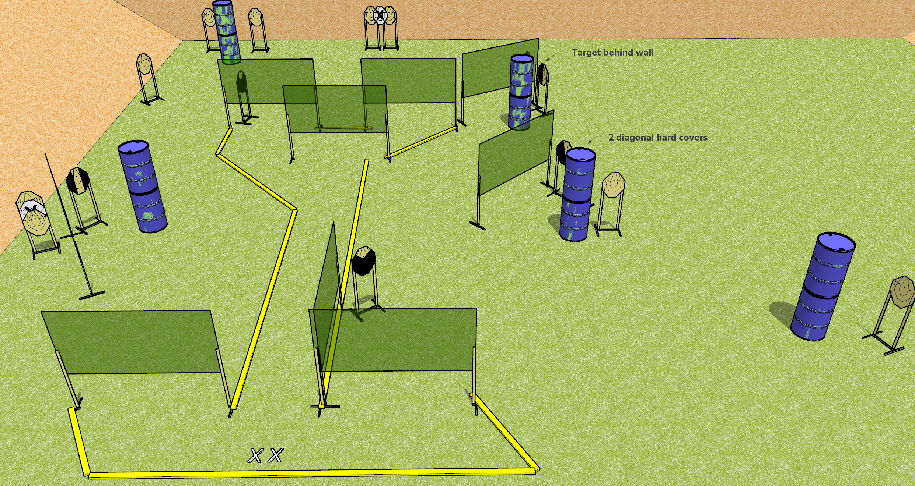
 | Dothan Gun Club – USPSA Match Whatcha Doin’? Course Designer : Drew Coleman
START POSITION : Standing with both feet on X’s, wrists below belt
GUN READY CONDITION : Pistol loaded and holstered. PCC loaded, buttstock on belt, safety on, pointed in a safe direction. |  | SCORING: Comstock, 34 rounds TARGETS: 17 paper, 0 Steel SCORED HITS: Best 2 on paper, steel until down START-STOP: Audible, last shot RULES:
STAGE PROCEDURE: Engage targets as they become available from within the fault lines.

